Slide 1
CSA-01
Introduction
Idea
Lí do/Như cầu
Procedure/Plan
How to use

Slide 2
CSA-01
Introduction
Idea
Why ?
Procedure
Demo
1

Slide 3
CSA-01
Introduction
Name : Mai An DEVILLE
Age : 16 years old
Class : CSA01
Idea
Why ?
Procedure
Demo
1

Slide 4
CSA-01
Mai An
Introduction
Main Idea :
- Chemistry data.
- Physics data.
- Brief overview of the experiment or study.
- Explain why the data was collected.
- Mention whether the data pertains to a specific subfield.
Idea
Why ?
Procedure
Demo
1

Slide 5
CSA-01
Useful for :
- Discuss the precision to ensure accuracy.
- Explain the statistical methods or analytical techniques.
- Highlight the main findings.
- Provides concrete examples for teaching.
Introduction
Idea
Why ?
Procedure
Demo
1

Slide 6
CSA-01
Introduction
Week 1 + 2 : Idea, what the data should be about
Week 3 : Coding (matplotlib)
Week 4 : Presentation, final production
Idea
Why ?
Procedure
Demo
1

Slide 7
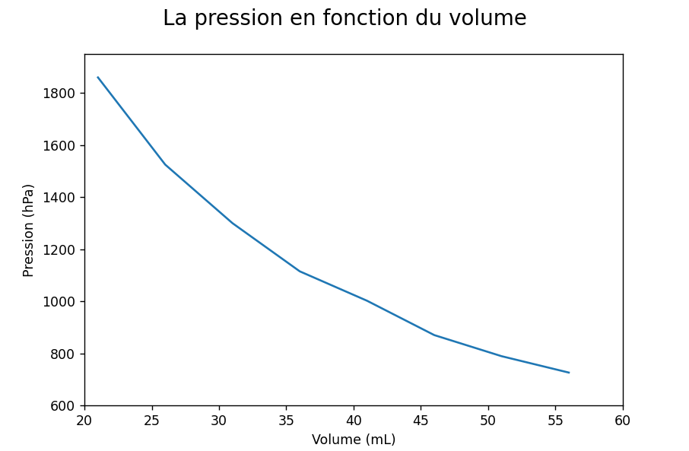
CSA-01
Introduction
Idea
Why ?
Procedure
Demo 1
1

Slide 8
CSA-01
Demo 1
Introduction
- Helps predict the behavior of gases under different conditions.
- Help predict weather patterns and phenomena like storms.
- Crucial across a wide range of fields : healthcare, environmental protection.
Idea
Why ?
Procedure
1

Slide 9
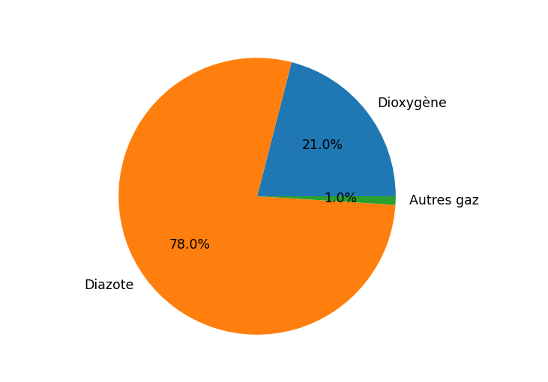
CSA-01
Demo 2
Introduction
- Vital for assessing air quality and its impact on human health.
- Essential for understanding their impact on global warming and climate change.
- Improves public health through air quality management.
- Crucial for environmental conservation efforts.
Idea
Why ?
Procedure
1

Slide 10
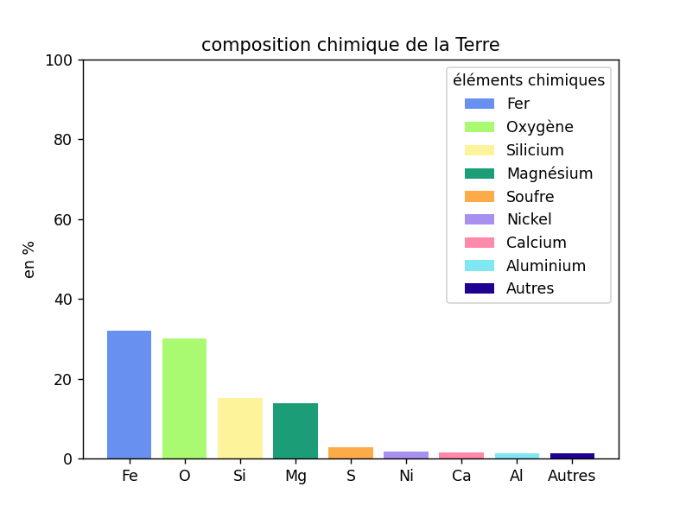
CSA-01
Demo 3
Introduction
- Comparison of each element’s .
- Chemical composition that helps understand the processes that formed and continue to shape the planet.
- Vital for constructing models of Earth's formation and evolution.
- Help identify and mitigate pollution sources.
Idea
Why ?
Procedure
1

Slide 11
CSA-01
Introduction
Idea
Why ?
Procedure
Demo 3
1

Slide 12
CSA-01
Introduction
Idea
Why ?
Procedure
Demo 3
1

Slide 13
CSA-01
Advantages
Disadvantages
Conclusion
2

Slide 14
CSA-01
Advantages
- Precise and accurate measurements.
- Reduces uncertainties and errors in experimental results.
- Support for theoretical models and hypotheses.
- Data from physics and chemistry can be applied to other fields.
- Accessible.
Disadvantages
Conclusion
2

Slide 15
CSA-01
- Amount of data generated can be overwhelming.
- Data analysis techniques require specialized knowledge and tools.
- Data collection and analysis can be time-consuming.
- Ambiguous or inconclusive.
- Reliance on technological tools and software.
Advantages
Disadvantages
Conclusion
2

Slide 16
CSA-01
- Data analysis used for multiple subjects and reasons.
- Useful for students, for education.
- Multiple disadvantages, more advantages.
Advantages
Disadvantages
Conclusion
2

Slide 17
CSA-01
- Data analysis used for multiple subjects and reasons.
- Useful for students, for education.
- Multiple disadvantages, more advantages.
Advantages
Disadvantages
Conclusion
2

Slide 18
CSA-01
Advantages
Disadvantages
Conclusion
2

Slide 19
CSA-01
Advantages
Disadvantages
Thank You
Conclusion
2

